Slide 1
ParaCodex Results

Slide 2
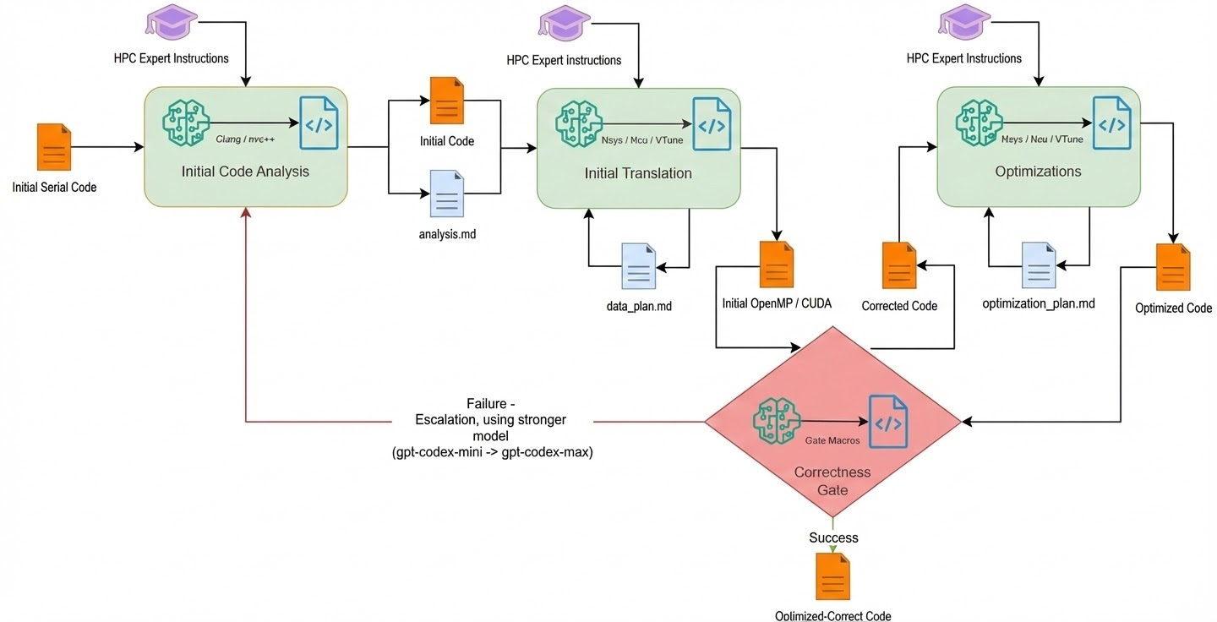
ParaCodex – Guided Parallelization Agent

Slide 3
Benchmarks
HECBench
Q: Can ParaCodex reliably translate and parallelize small, isolated HPC kernels with clear loop structures?
Used to validate baseline correctness, loop-parallelization quality, and GPU offload stability.
Rodinia
Q: Can ParaCodex handle real, irregular, application-level GPU workloads with complex memory patterns and control divergence?
Tests scalability of the agentic pipeline, robustness on heterogeneous domains, and its ability to match real-world GPU programming idioms.
NAS Parallel Benchmarks (NPB)
Q: Can ParaCodex handle a performance-aware parallel code for classic HPC motifs that stress communication, decomposition, and nested parallel loops?
Evaluates whether the system can achieve high-quality parallelization and offload on canonical scientific kernels used for cluster-level performance studies.

Slide 4
Benchmarks
ParEval
Q:Can Codex translate between parallel api’s?
Tested *Codex* on the Pareval kernels to measure the capabilities of codex on translating code between parallel api’s.

Slide 5
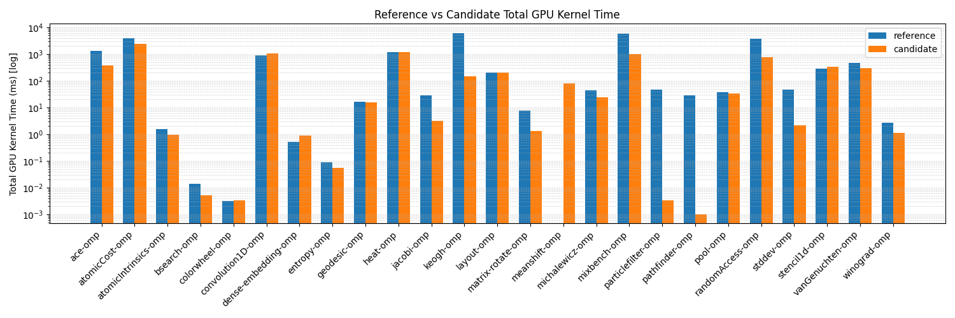
RQ1: Can ParaCodex create correct & optimized parallel code ?
ANS1: Yes, on 76% of the Hecbench codes

Slide 6
RQ1: Can ParaCodex create correct & optimized parallel code ?
ANS1: Yes, often by a lot
kernel-name | Reference (ms) | candidate-ParaCodex (ms) | Speedup | 1-if speedup 0-if not
ace-omp | 1271.5508 | 363.7893 | 3.4953 | 1
atomicCost-omp | 3840.8302 | 2336.4017 | 1.6439 | 1
atomicIntrinsics-omp | 1.5507 | 0.9494 | 1.6334 | 1
bsearch-omp | 0.0138 | 0.0053 | 2.6060 | 1
colorwheel-omp | 0.0032 | 0.0033 | 0.9739 | 0
convolution1D-omp | 907.2729 | 1041.9738 | 0.8707 | 0
dense-embedding-omp | 0.5173 | 0.8741 | 0.5918 | 0
entropy-omp | 0.0895 | 0.0543 | 1.6474 | 1
geodesic-omp | 16.6456 | 15.6171 | 1.0659 | 1
heat-omp | 1194.7852 | 1198.7119 | 0.9967 | 0
jacobi-omp | 27.4342 | 3.0859 | 8.8901 | 1
keogh-omp | 6186.7967 | 142.5745 | 43.3934 | 1
layout-omp | 206.4583 | 204.9066 | 1.0076 | 1
matrix-rotate-omp | 7.6142 | 1.2917 | 5.8945 | 1
meanshift-omp | nan | 80.3619 | nan | 0
michalewicz-omp | 43.3745 | 24.4771 | 1.7720 | 1
mixbench-omp | 5885.8227 | 1010.8261 | 5.8228 | 1
particlefilter-omp | 46.2105 | 0.0033 | 14065.6898 | 1
pathfinder-omp | 28.3866 | 0.0010 | 28625.1526 | 1
pool-omp | 37.7783 | 33.8897 | 1.1147 | 1
randomAccess-omp | 3631.2508 | 744.4224 | 4.8779 | 1
stddev-omp | 45.7333 | 2.0915 | 21.8666 | 1
stencil1d-omp | 289.0810 | 336.8094 | 0.8583 | 0
vanGenuchten-omp | 459.2897 | 302.2992 | 1.5193 | 1
winograd-omp | 2.6092 | 1.0968 | 2.3790 | 1

Slide 7
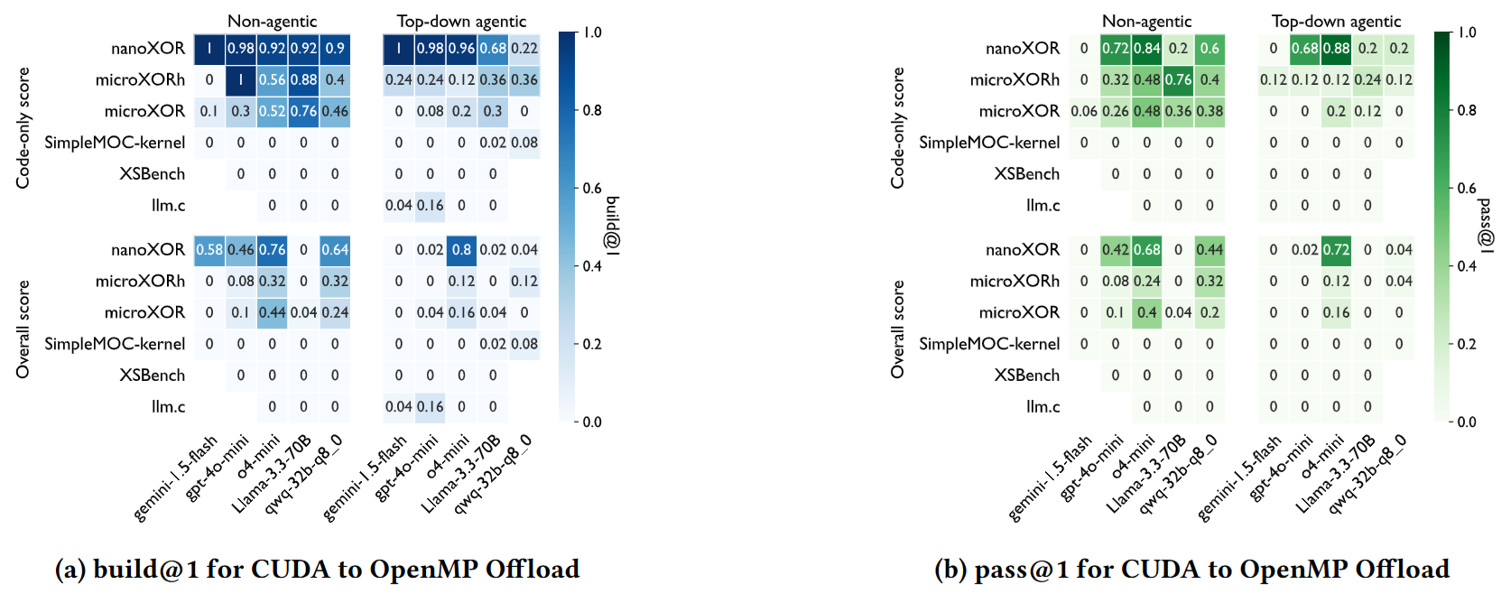
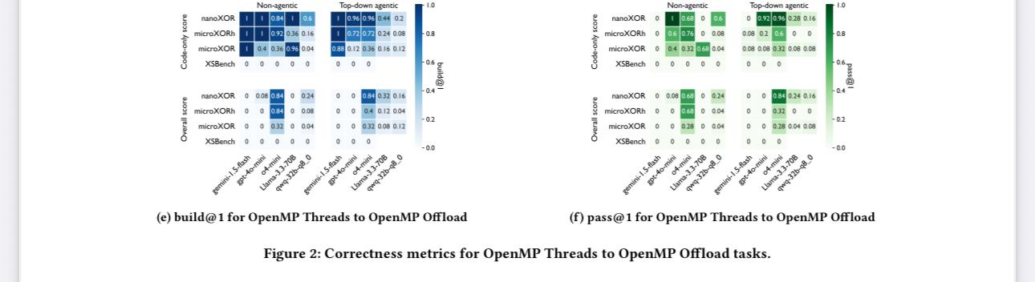
RQ2: Can Codex Translate between Parallel API’s ?
ANS2:CUDA TO OMP
chrome-extension://efaidnbmnnnibpcajpcglclefindmkaj/https://arxiv.org/pdf/2506.20938

Slide 8
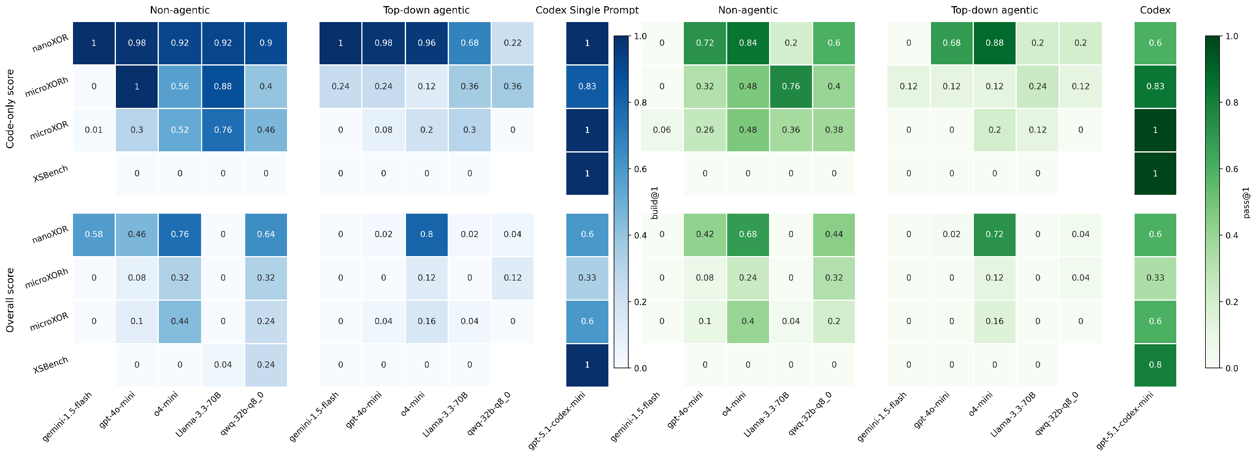
RQ2: Can Codex Translate between Parallel API’s ?
ANS2:CUDA TO OMP

Slide 9
RQ3: Can ParaCodex work with more complex code (NAS, Rodinia) ?
ANS3: Yes, NAS improvement in 4/4 of the Kernels
NAS Parallel Benchmarks (NPB)
Developed by NASA to model computational fluid dynamics (CFD) workloads.
Focus on communication patterns, and scalability.
Kernels are compact, synthetic, representing algorithmic motifs (CG, FT, EP, MG).
Rodinia Benchmark Suite
Designed to represent heterogeneous workloads (CPU, GPU, accelerators).
Targets data-parallel applications such as medical imaging, machine learning, graph algorithms, physics simulations.
Focus on real application behavior, memory patterns, and GPU architectural stress.
*complex - Rodinia provides full real-world heterogeneous workloads, and NAS offers compact, standardized pseudo-applications designed to benchmark parallel scalability and algorithmic structure.

Slide 10
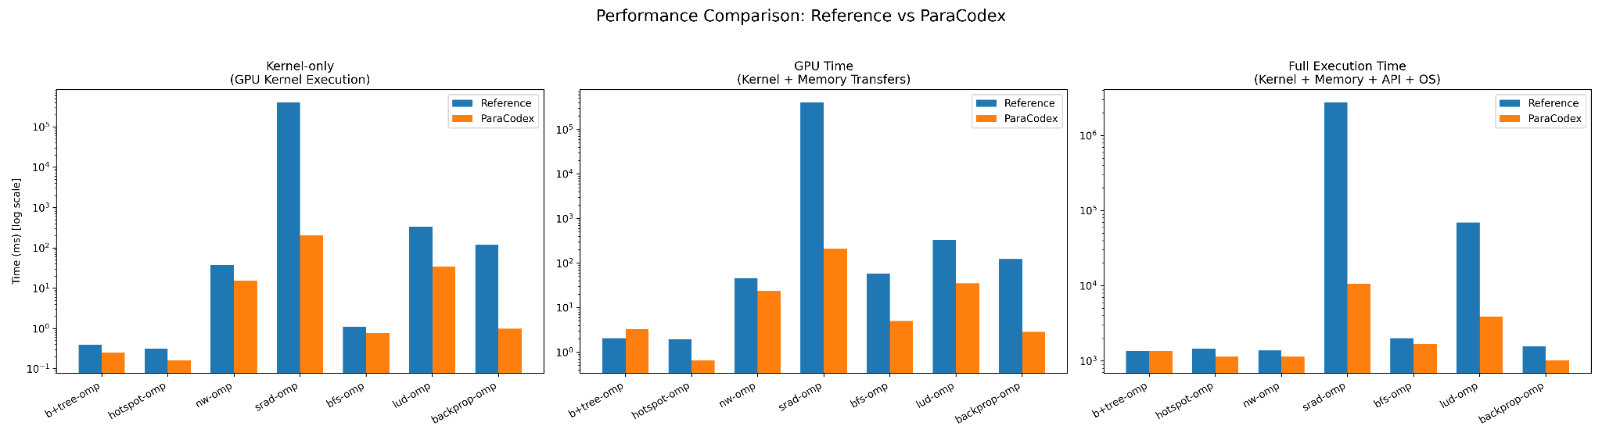
Rodinia Results

Slide 11
Benchmark | Kernel Reference (ms) | Kernel ParaCodex (ms) | Kernel Faster? | GPU Reference (ms) | GPU ParaCodex (ms) | GPU Faster? | Full Reference (ms) | Full ParaCodex (ms) | Full Faster?
b+tree-omp | 0.39 | 0.25 | 1 | 2.06 | 3.28 | 0 | 1349.05 | 1340.27 | 1
hotspot-omp | 0.31 | 0.16 | 1 | 1.95 | 0.66 | 1 | 1451.85 | 1146.99 | 1
nw-omp | 37.83 | 15.19 | 1 | 45.94 | 23.52 | 1 | 1370.41 | 1139.66 | 1
srad-omp | 403,112.75 | 204.32 | 1 | 403,116.81 | 208.24 | 1 | 2,755,297.59 | 10,712.70 | 1
bfs-omp | 1.09 | 0.78 | 1 | 58.96 | 5.00 | 1 | 2013.15 | 1695.12 | 1
lud-omp | 331.48 | 34.17 | 1 | 332.15 | 34.85 | 1 | 69,804.71 | 3886.49 | 1
backprop-omp | 120.86 | 0.99 | 1 | 122.78 | 2.86 | 1 | 1576.15 | 1022.08 | 1

Slide 12
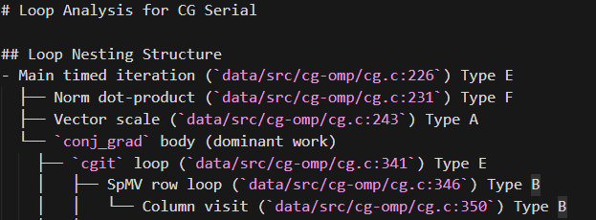
Analysis - CG

Slide 13
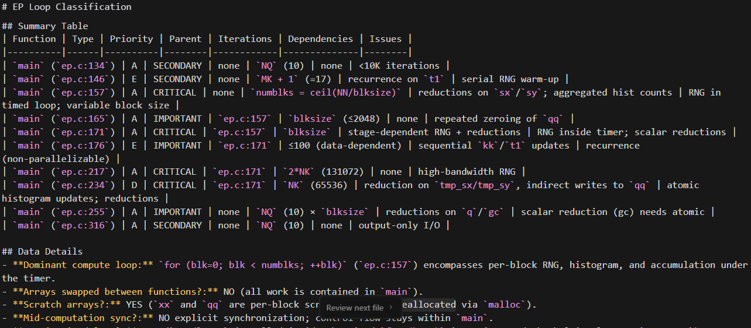
Analysis - EP

Slide 14
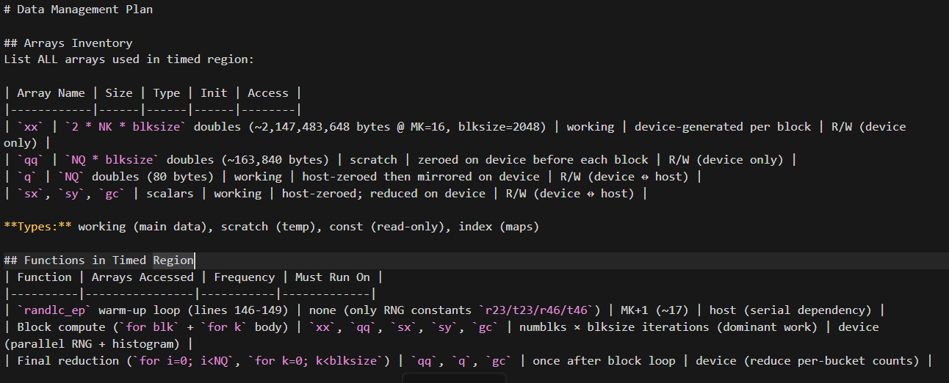
Data Plan - EP

Slide 15
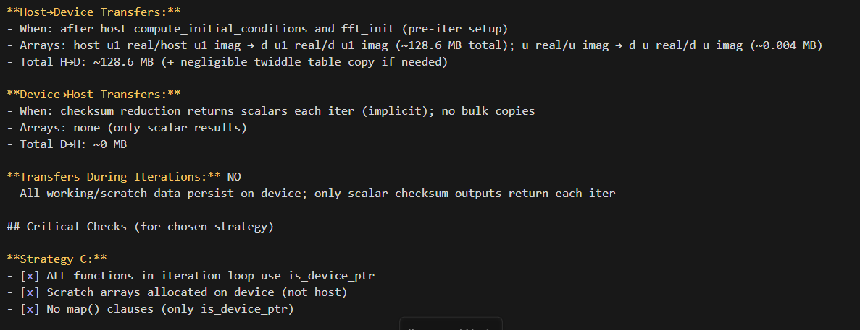
Data Plan – (FT)

Slide 16
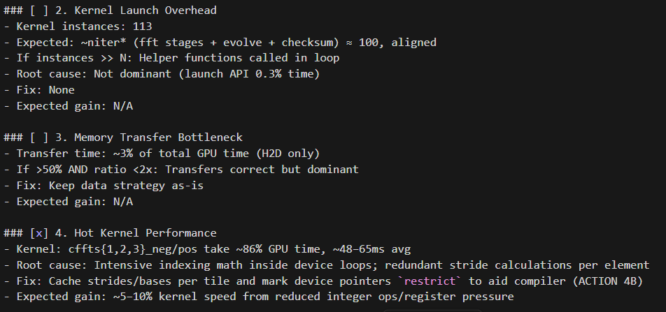
Optimization Plan – (FT)

Slide 17
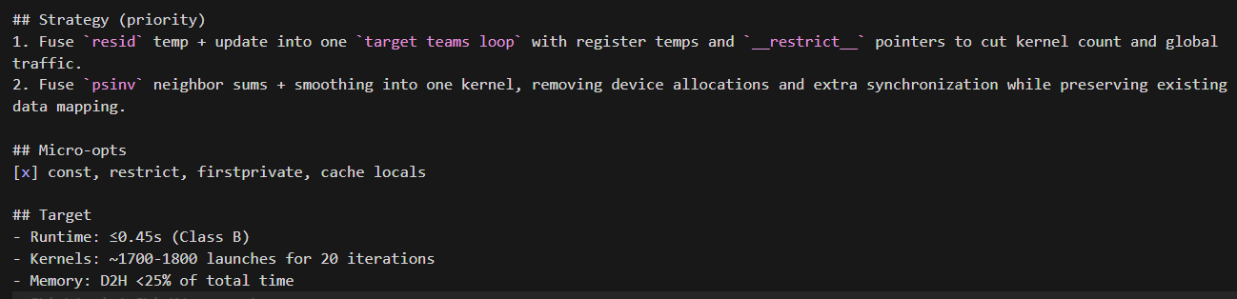
Optimization Plan – (MG)

Slide 18
Performance Measurement
# Nsight Systems Performance Metrics
## Three Measurement Types
### 1️⃣ Kernel-only
[5/7] cuda_gpu_kern_sum
─────────────────────────────────────
Time (ns) Name
─────────────────────────────────────
... nvkernel_conj_grad
... nvkernel_other
... nvkernel_small
─────────────────────────────────────
**Pure GPU compute time** - Sum of all GPU kernel execution times
### 2️⃣ GPU Time
Kernel-only + Memory Transfers
[6/7] cuda_gpu_mem_time_sum
─────────────────────────────────────
Time (ns) Operation
─────────────────────────────────────
... [CUDA memcpy HtoD]
... [CUDA memcpy DtoH]
... [CUDA memset]
─────────────────────────────────────
```
**GPU-side work** - Compute kernels + GPU memory transfers.

Slide 19
Performance Measurement
### 3️⃣ Full Execution Time
```
Kernel + Memory + CUDA API + OS Runtime
[4/7] cuda_api_sum [3/7] osrt_sum
───────────────────── ─────────────────────
... sync ... poll
... launch ... ioctl
───────────────────── ─────────────────────
**Total runtime** - Everything (compute + memory + API overhead + OS calls)
---
## Summary
| Metric | Components | Use Case |
|--------|-----------|----------|
| **Kernel-only** | GPU kernels only | Pure compute performance |
| **GPU Time** | Kernels + Memory | GPU-side|
| **Full Time** | All components | Full Application|

Slide 20
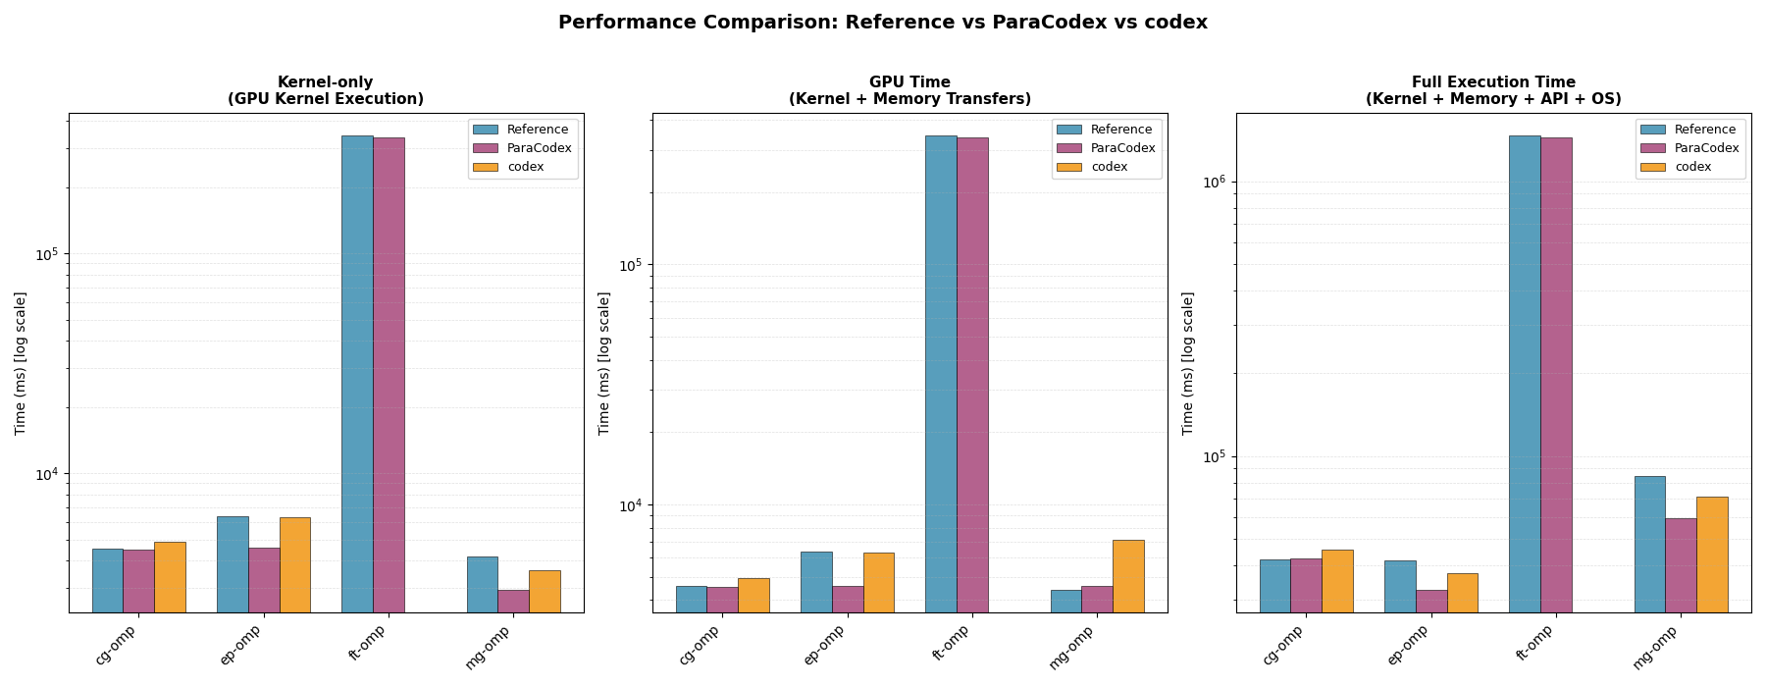
NAS Results [CG, EP, FT, MG] (serial -> OMP)
http://localhost:8000/results_table.html

